Slide 1
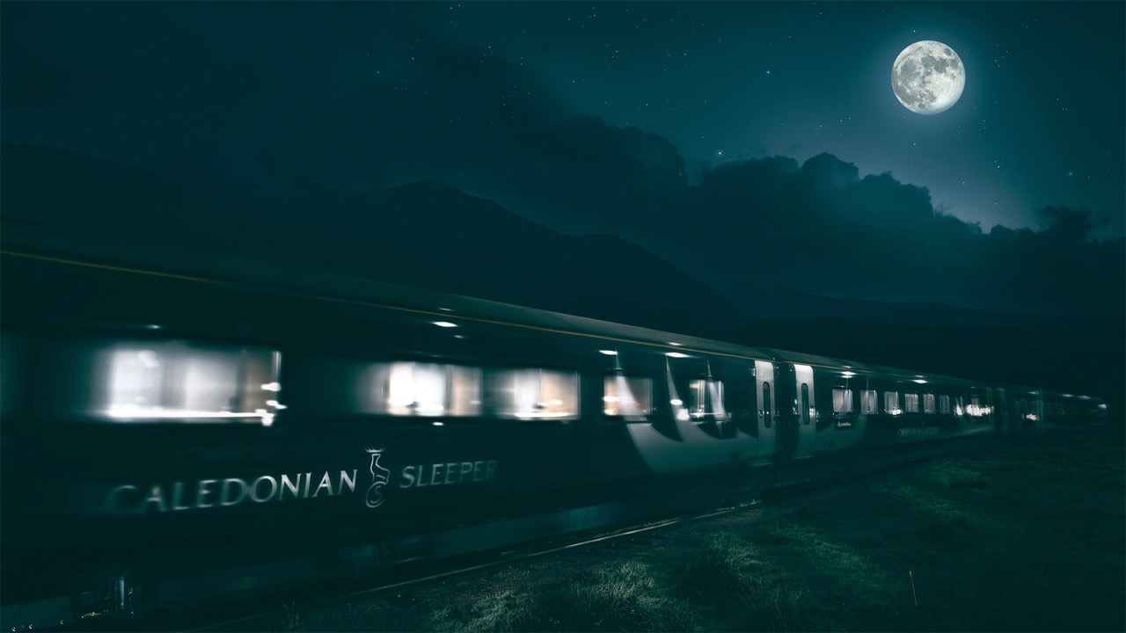
Caledonian Sleeper
A unique way to travel

Slide 2
The Caledonian Sleeper is the longest passenger train in the UK - over ¼ mile long!
Every night (except Saturday) of the week we have:
over 400 rooms (including double bed guestrooms!)
over 300 toilets (including private en-suite shower rooms)
over 250 seats
over 400 bottles of whisky (wee ones)
at max capacity over 1,000 guests

Slide 3
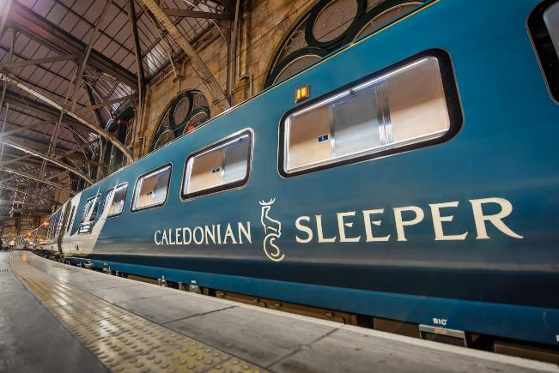
Take a look onboard…
Click image to view video on YouTube

Slide 4
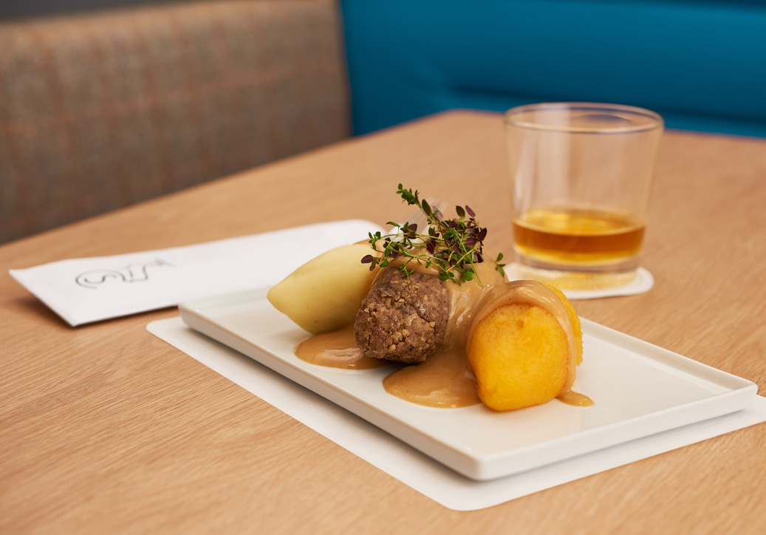
Why Caledonian Sleeper?
Snooze your way to your destination and save money on a hotel night
Time saving, you travel overnight so can pack more into your day
No more red eye early morning flights
Land in the heart of the city; no long airport queues or expensive city transfers
Environmentally friendly way to travel
No long waits for luggage and no extra fees
Club Car & Passenger Lounge access for Club Room & Caledonian Double Room guests
Club Car experience for breakfast, dinner or a whisky en-route
20% discount for onward travel with ScotRail

Slide 5
Our Destinations

Slide 7
Our Guestrooms
Caledonian Sleeper offers three room types

Slide 8
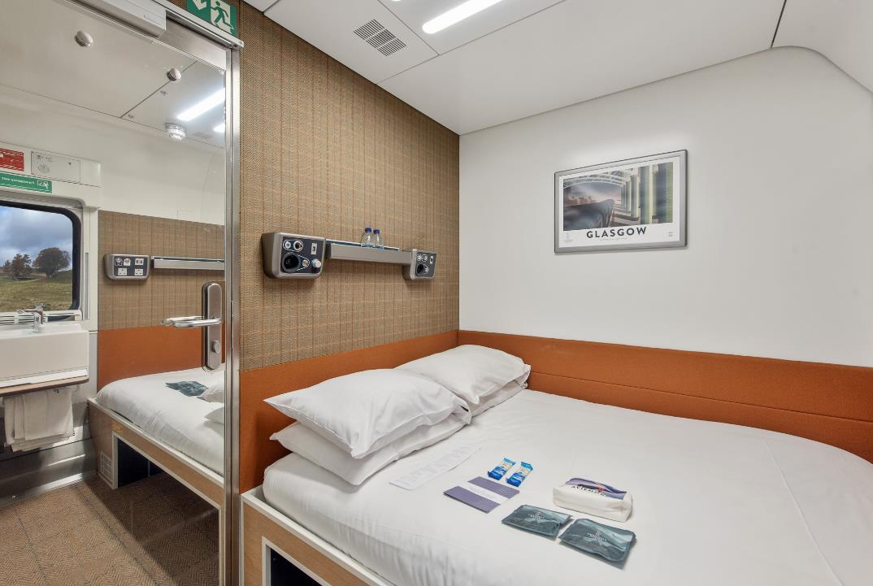
Caledonian Double En-suite Room features
Flagship room with Double bed
Private en-suite shower room
Priority Club Car access
Breakfast included
Souvenir Arran Sense of Scotland toiletry bag
Mackies of Scotland chocolate gift
Handcrafted mattress by Glencraft
Sleep kit
Complimentary WiFi
USB & electrical charging points
Room service available

Slide 9
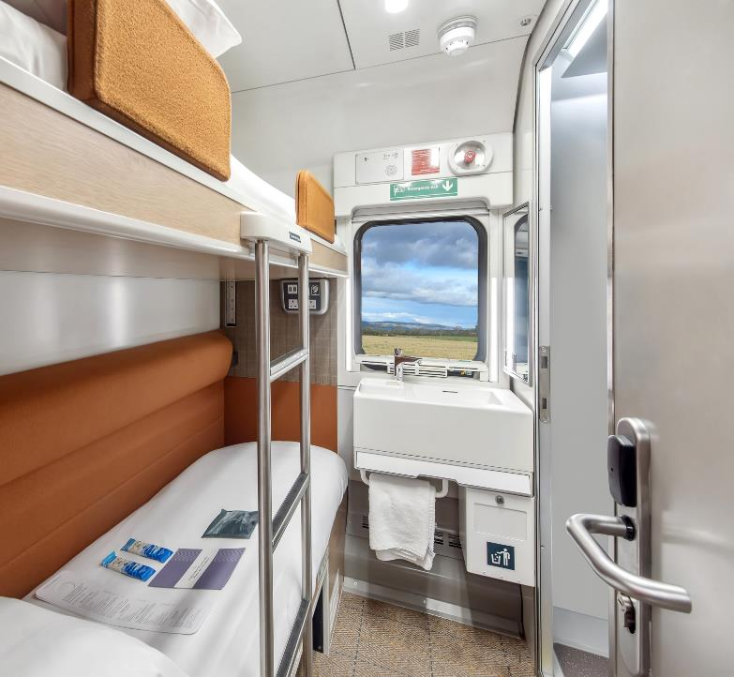
Club Twin En-suite Room features
Twin bunk bed room
Private en-suite shower room
Priority Club Car access
Breakfast included
Arran Sense of Scotland toiletries
Mackies of Scotland chocolate gift
Handcrafted mattress by Glencraft
Sleep kit
Complimentary WiFi
USB & electrical charging points
Room service available

Slide 10
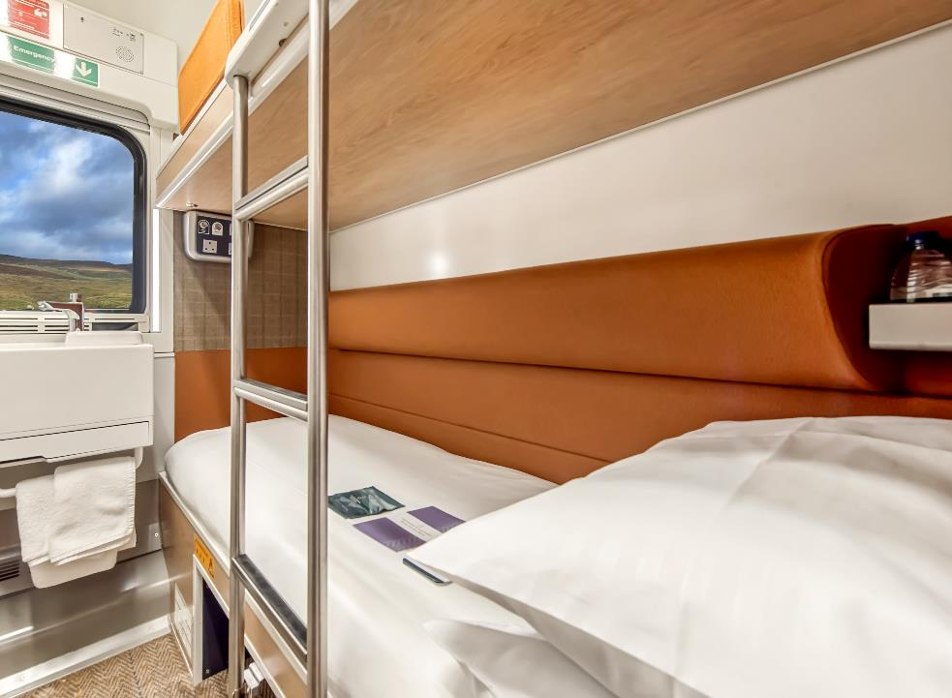
Classic Twin Room features
Twin bunk bed room
Handcrafted mattress by Glencraft
Sleep kit
Complimentary WiFi
USB & electrical charging points
In room wash basin
Breakfast available to purchase
Room service available
Interconnecting Classic rooms available

Slide 11
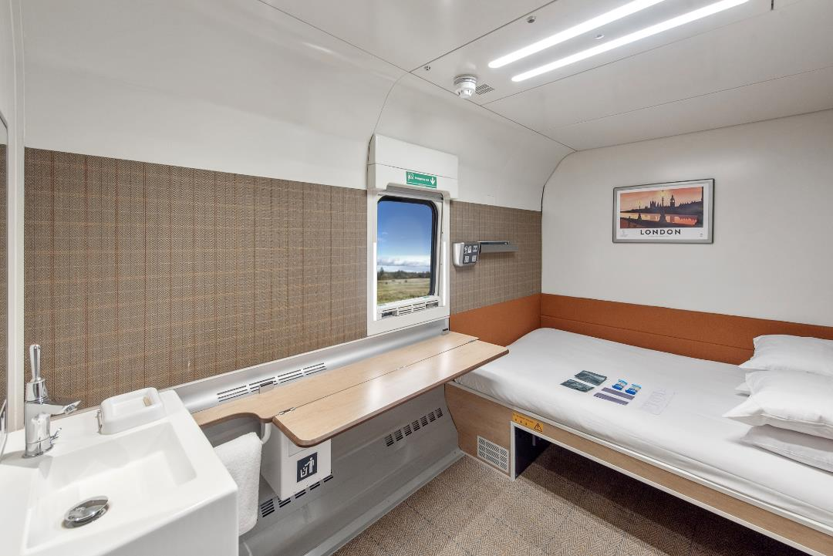
Accessible Double Room features
Double bed
Handcrafted mattress by Glencraft
Sleep kit
Complimentary WiFi
USB & electrical charging points
In room wash basin
Breakfast available to purchase
Room service available

Slide 12
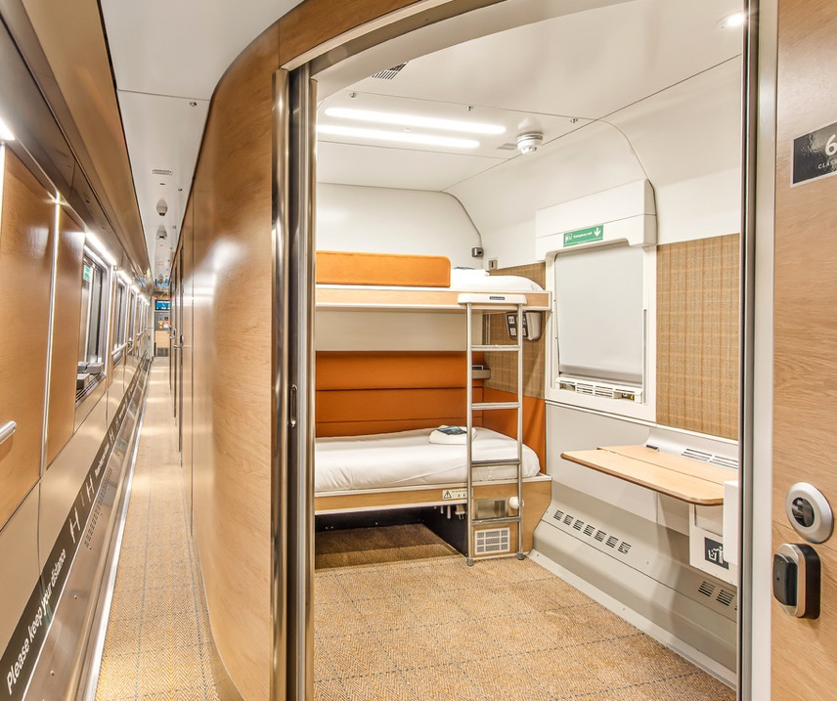
Accessible Twin Room features
Twin bunk bed room
Handcrafted mattress by Glencraft
Sleep kit
Complimentary WiFi
USB & electrical charging points
In room wash basin
Breakfast available to purchase
Room service available

Slide 13
Our Onboard Experience

Slide 14
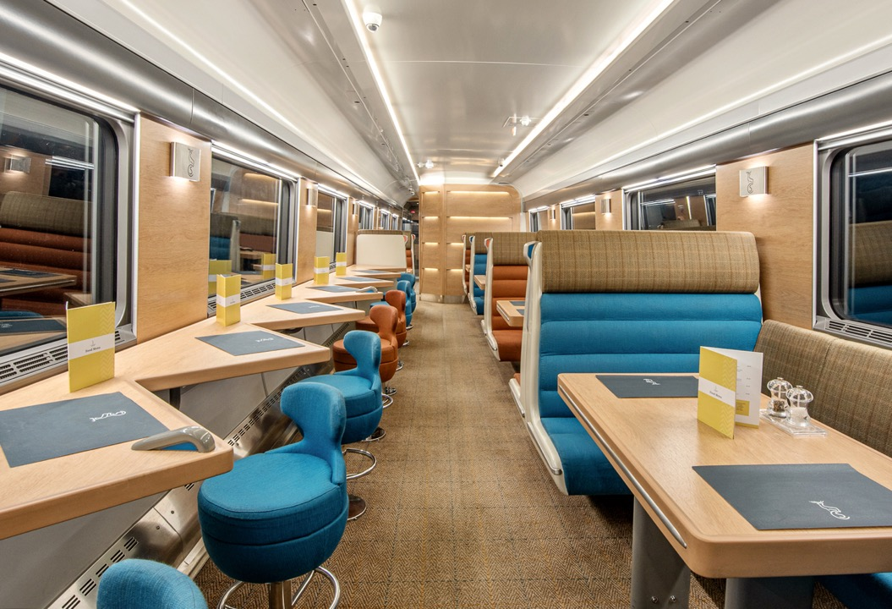
Enjoy a culinary taste of Scotland with a difference in our unique Club Car
Priority access to the Club Car for Caledonian Double & Club Room guests
Available for breakfast and dinner service
Electrical & USB charging points available

Slide 15
Our Lounges

Slide 16
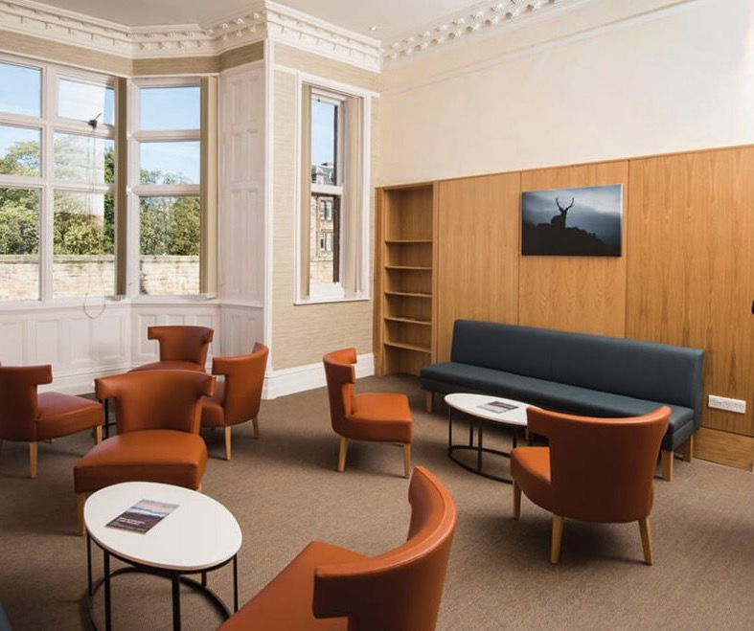
To enhance the experience for our Caledonian Double and Club Room guests we have created our own complimentary pre-departure/arrival lounges at a number of stations
Caledonian Sleeper branded lounges at the following locations:
- Dundee - Fort William
- Inverness
- Leuchars
- Perth
- London Euston (coming soon)
Complimentary access to First Class lounges ran by other operators is available at London Euston, Edinburgh Waverley, Glasgow Central and Aberdeen for our Caledonian Double & Club Room guests

Slide 17
Our Train & the Environment

Slide 18
The Sleeper is Greener!
kg of CO2 Equivalent, per Passenger, per Mile
Caledonian Sleeper generates almost 7 TIMES LESS carbon emissions than the average UK domestic flight.
*The Caledonian Sleeper performance has been compared with published data for other transport modes using the UK Government’s “Greenhouse gas reporting: conversion factors 2022”[1] data. SNC Lavalin November 2022

Slide 19
Caledonian Sleeper is your hotel room for the night making it even more green when compared to other modes plus hotel
London > Edinburgh
London > Glasgow
 | Distance (Miles) | Travel kgCO2e/p | Hotel kgCO2e/p | Total kgCO2e/p
Caledonian Sleeper | 400 | 17.8 | n/a | 17.8
Sleeper at Capacity | 400 | 12.5 | n/a | 12.5
Car Diesel | 378 | 90.9 | 13.9 | 104.8
Car Petrol | 378 | 94.1 | 13.9 | 108.0
Domestic Flight | 332 | 146.1 | 13.9 | 160.0
National Rail | 332 | 22.9 | 13.9 | 36.8
Distance (Miles) | Travel kgCO2e/p | Hotel kgCO2e/p | Total kgCO2e/p
400 | 17.8 | n/a | 17.8
400 | 12.5 | n/a | 12.5
403 | 91.6 | 13.9 | 105.5
403 | 94.8 | 13.9 | 108.7
346 | 152.2 | 13.9 | 166.1
401 | 27.6 | 13.9 | 41.5
Comparison of London to Edinburgh / Glasgow Journeys per Passenger. SNC Lavalin November 2022

Slide 20
How To Book

Slide 21
Book direct via Caledonian Sleeper:
www.sleeper.scot
Via Evolvi
Via Trainline for Business
To discuss Caledonian Sleeper in more detail:
Gail Wands
Business Development Manager
gail.wands@serco.com
07458 050844

